Slide 1

AI-Powered IT Helpdesk and Intelligent Support Management System
Arnav Kumar
Organization : GlobalLogic
Mentor : Poonam Gera Ma’am

Slide 2
Problem Statement & Motivation
Employees face hardware, software, network, and account-access issues
Informal/manual complaint tracking is hard to prioritize and resolve
Solution: centralized helpdesk with structured ticketing + AI chatbot for first-level support
AI reduces repetitive queries; unresolved issues escalate to human agents

Slide 3
Project Objectives
Build a full-stack IT helpdesk application
Implement JWT authentication and RBAC
Create complete ticket lifecycle management
Implement department-based ticket routing
Provide role-specific dashboards
Integrate Google Gemini for first-level IT support
Use a Knowledge Base to ground AI responses
Implement an Approved Software Registry
Provide email-based onboarding and password recovery
Support authorized Excel ticket export
Deploy the complete system using Docker Compose

Slide 4
Technology Stack
Layer | Technologies
Frontend | React 18, Vite, React Router, Axios
Backend | Python 3.11, FastAPI, Uvicorn, Pydantic
Relational Database | Microsoft SQL Server, SQLAlchemy, Alembic
Document Database | MongoDB, PyMongo
AI | Google Gemini
Security | JWT, python-jose, bcrypt
Reporting | openpyxl
Infrastructure | Docker Compose, Nginx

Slide 5
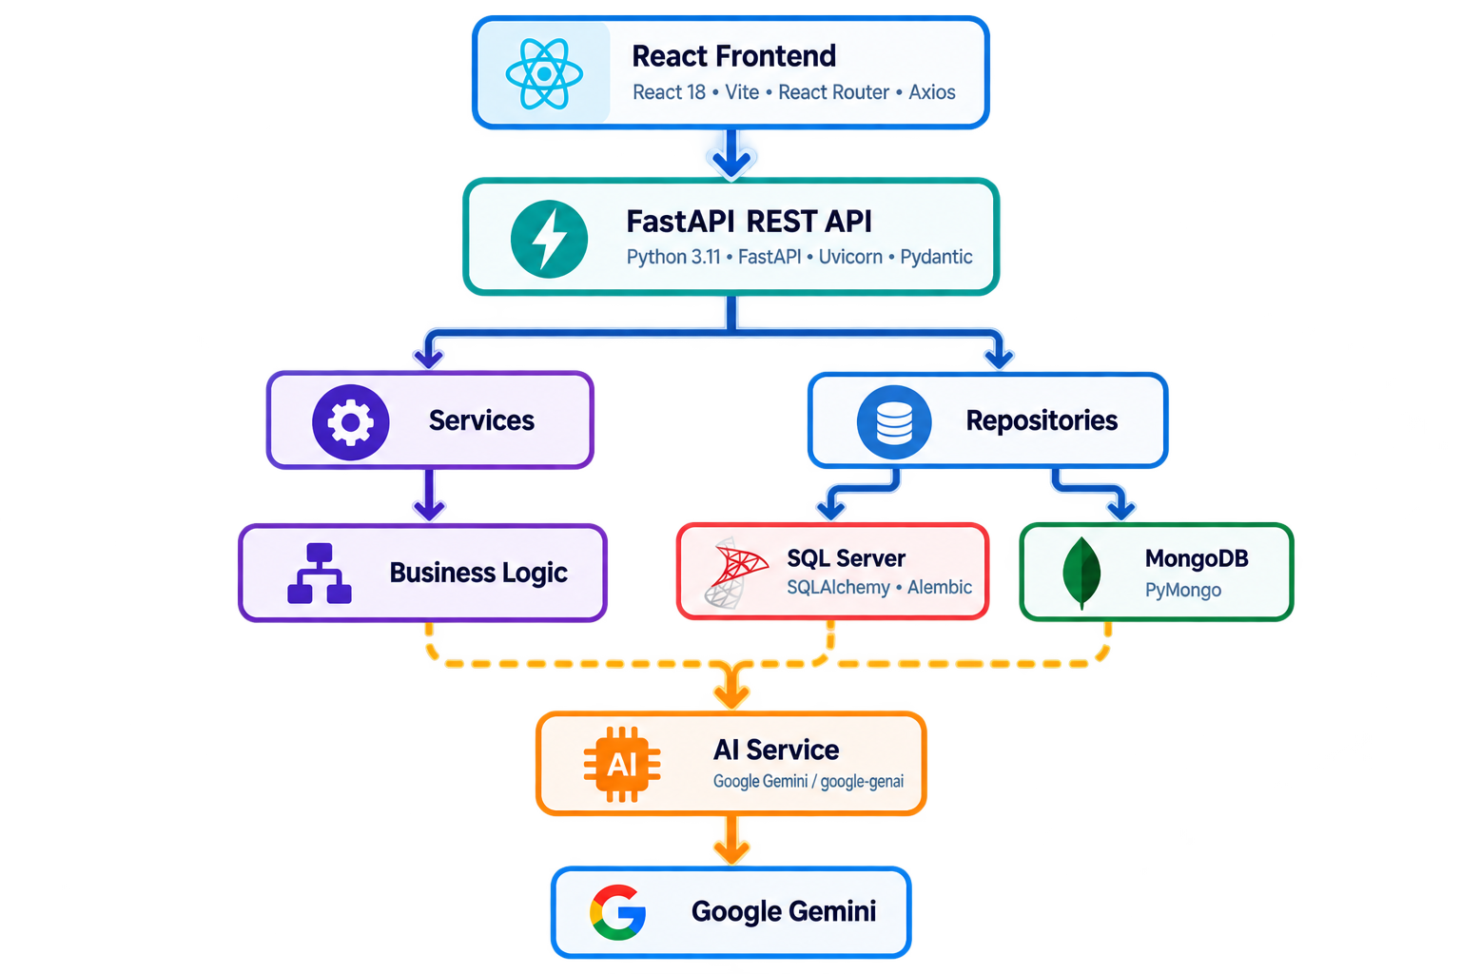
System Architecture
Layered architecture: Browser (React) → FastAPI (Routes → Services → Repositories) → SQL Server / MongoDB
AI Service calls Google Gemini separately

Slide 6
Role Based Access Control (RBAC)
Administrator
IT Agent
Manage users
Manage roles/departments
Maintain software registry
Monitor system health
Handles tickets assigned to their department
IT Manager
End User :
Organization-wide ticket oversight
Create and view their own tickets
Use self service support

Slide 7
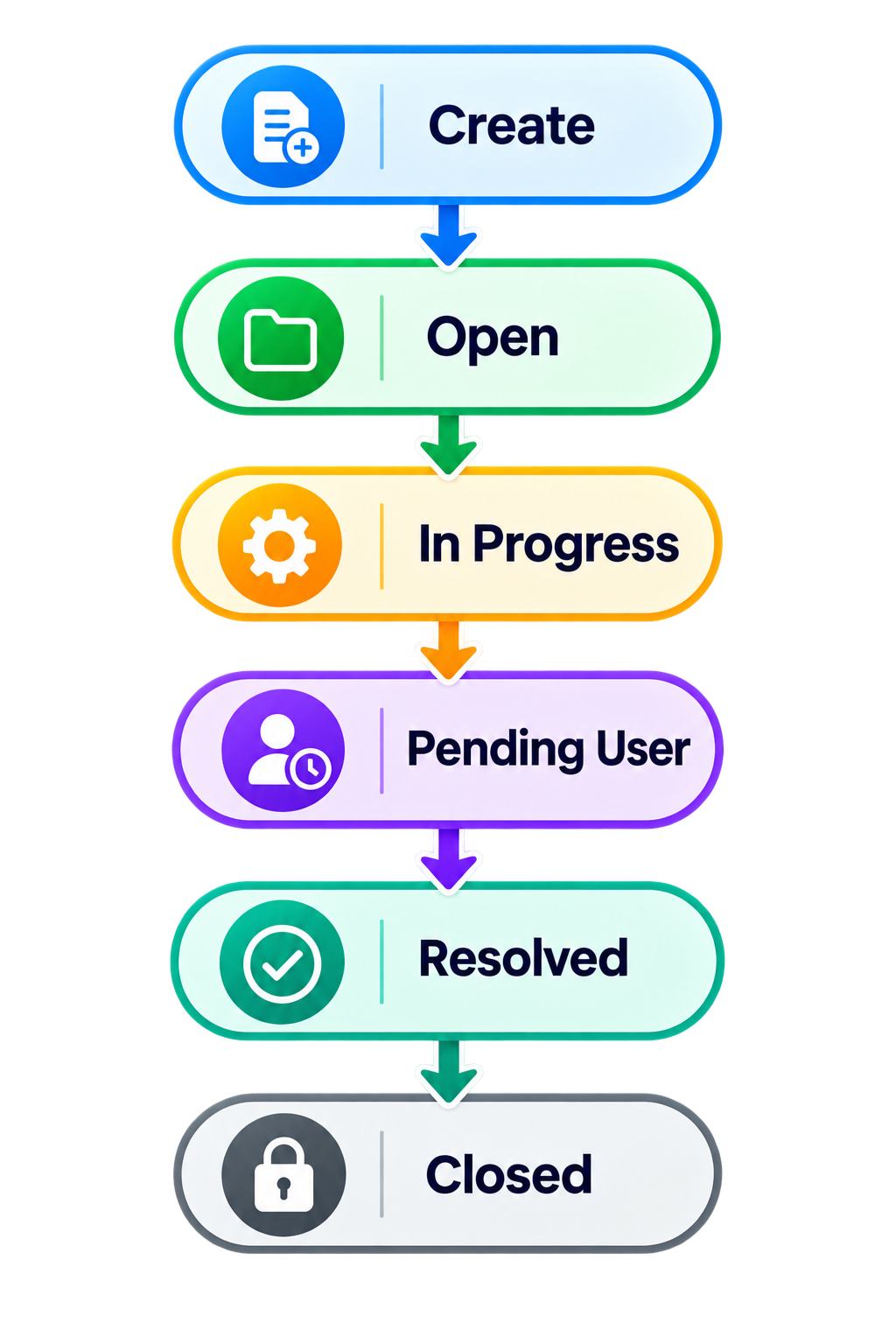
Ticket Creation Workflow

Slide 8
Role Specific Dashboard
Role | Dashboard Focus
Administrator | System administration & health
IT Manager | Overall ticket workload
IT Agent | Department-specific workload
End User | Own tickets & activity

Slide 9
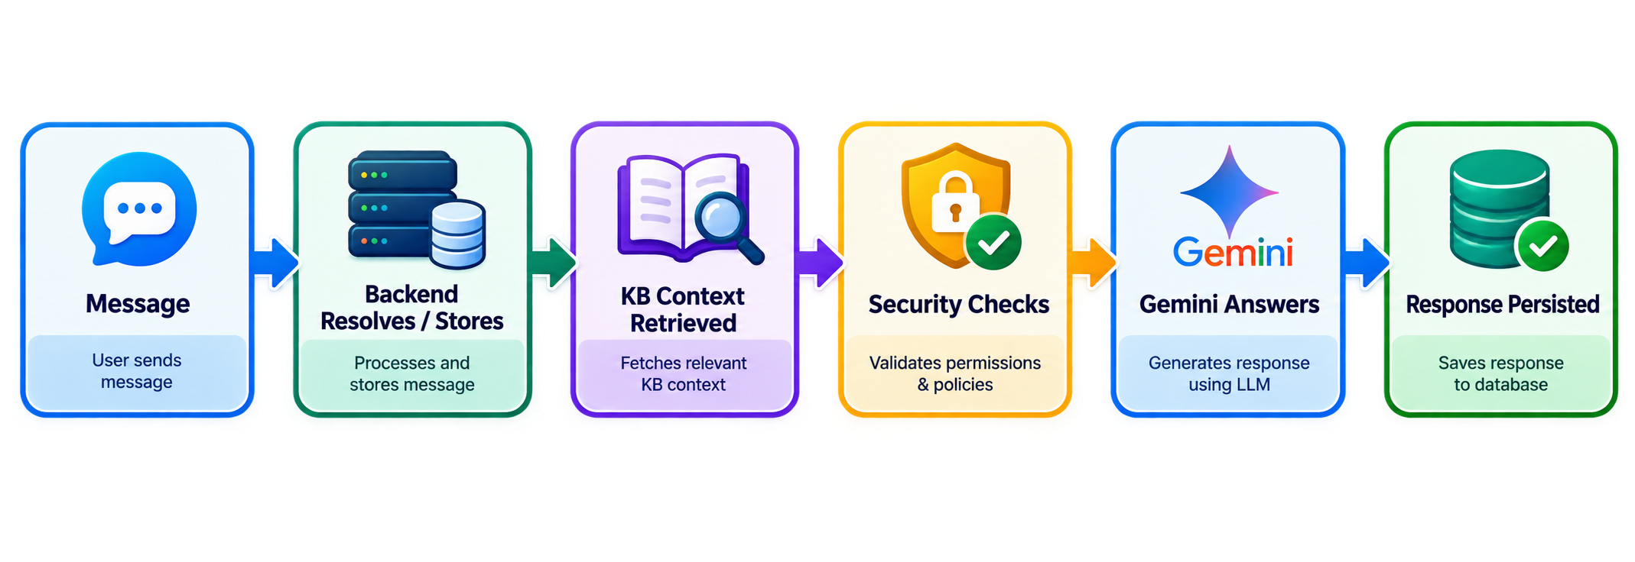
AI Assistant and Knowledge Base
Google Gemini for first-level problem solving
Conversation history stored in MongoDB (context-aware follow-ups)

Slide 10
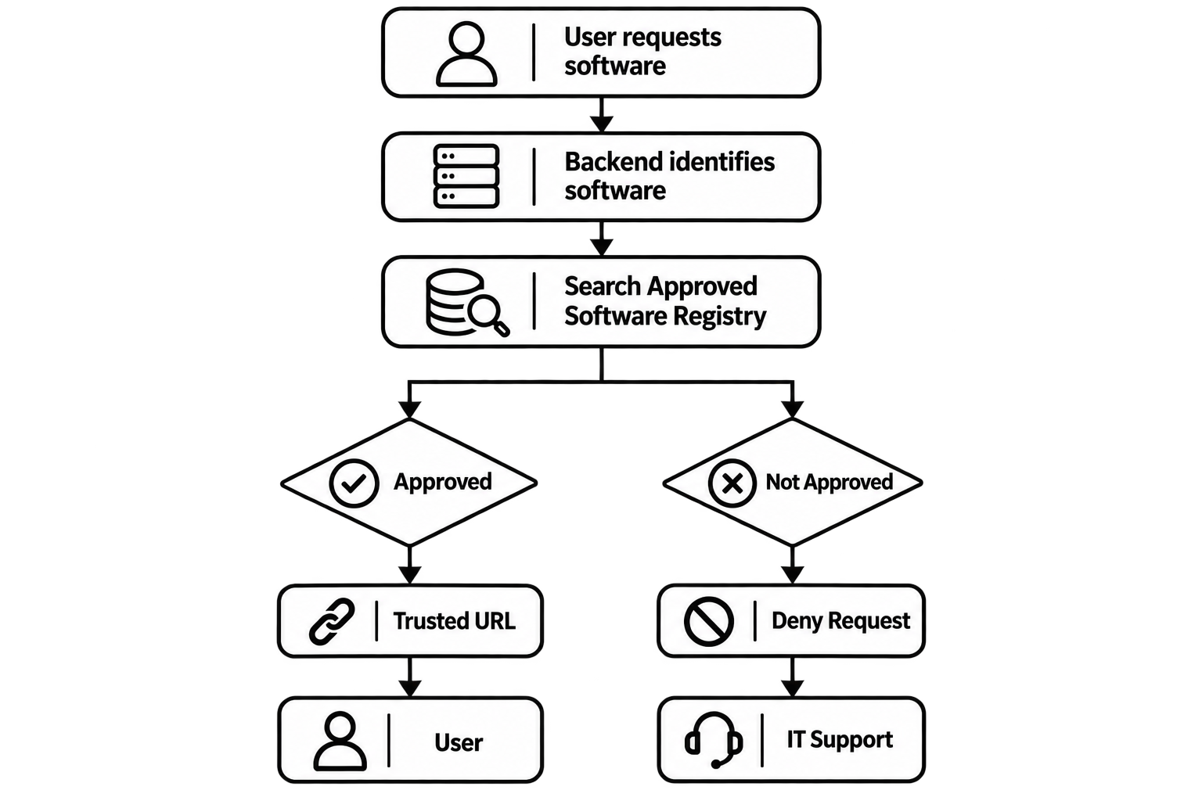
Software Authorization
Approved software registry
One of the key features of the project is controlling software download recommendations through a company-approved registry.
The Problem
An AI model should not decide whether software is approved by the organization.

Slide 11
Administration, Reporting & Deployment
Administrators can :
Create/manage user accounts
Assign roles and departments
Activate/deactivate accounts
Maintain Approved Software Registry
Monitor database/service health
The application runs using docker compose :
Docker Compose
│
├── Frontend / Nginx → 3000
├── FastAPI Backend → 8000
├── SQL Server → 1433
└── MongoDB → 27017

Slide 12
Thank You

